Slide 1


Telecom Customer Churn Prediction & Retention Strategy
Data-Driven Product Analytics & AI-Based Risk Scoring
Presented by: Tushar Pillay

Slide 2
BUSINESS CHALLENGE
Addressing Critical Churn Challenges
Our current churn rate significantly impacts revenue and growth, demanding a strategic, proactive approach.
1
2
High Churn Rate
Revenue Leakage
At 26.54%, our churn is 6% above the industry benchmark, leading to substantial customer attrition.
Each lost customer translates directly into foregone revenue, eroding profitability.
3
4
Soaring Acquisition Costs
Proactive Prevention Gap
Replacing churned customers is increasingly expensive, straining marketing budgets.
Lack of early intervention leads to reactive, less effective retention efforts.

Slide 3





METHODOLOGY
Our Data-Driven Approach
Leveraging advanced analytics and AI for precise churn prediction and customer segmentation.
Predictive Modeling
Data Collection
Risk Scoring
Strategy Development
Analysis of 7,043 customer records informed a robust Logistic Regression model, establishing a comprehensive risk scoring system.

Slide 4

KEY FINDINGS
Unpacking Churn Drivers & Protectors
Our analysis reveals critical factors influencing customer attrition and loyalty across different segments.
Significant Churn Drivers
Month-to-month contracts lead to lower commitment.
Electronic check payments correlate with higher churn risk.
Customers with less than 12 months tenure are highly vulnerable.
High monthly charges without perceived value increase dissatisfaction.
Key Protective Factors
2-year contracts foster long-term loyalty.
Automatic payments enhance customer stickiness.
Multiple service adoption deepens engagement.
Tenure beyond 24 months signals strong retention.

Slide 5




CUSTOMER INSIGHTS
Understanding Our Customer Personas
Segmentation allows for targeted interventions, maximizing retention efforts.
At-Risk Budget User
Value Seeker
Loyal Family User
Other Segments
Sensitive to price, often on month-to-month contracts, high churn potential.
Seeks perceived value for cost; vulnerable if service engagement is low.
Multi-service subscriber, long tenure, low churn risk, high CLV.
Varied profiles with distinct churn behaviors and CLV impacts.

Slide 6




ENGAGEMENT
Driving Retention Through Engagement
Factors that enhance customer stickiness and build lasting relationships.
Service Adoption
Automatic Payments
Customers using multiple services show higher loyalty.
Automated billing reduces friction and improves retention.
Contract Commitment
Stickiness Score
Longer contract terms significantly increase customer stickiness.
Direct correlation between engagement and reduced churn risk.

Slide 7
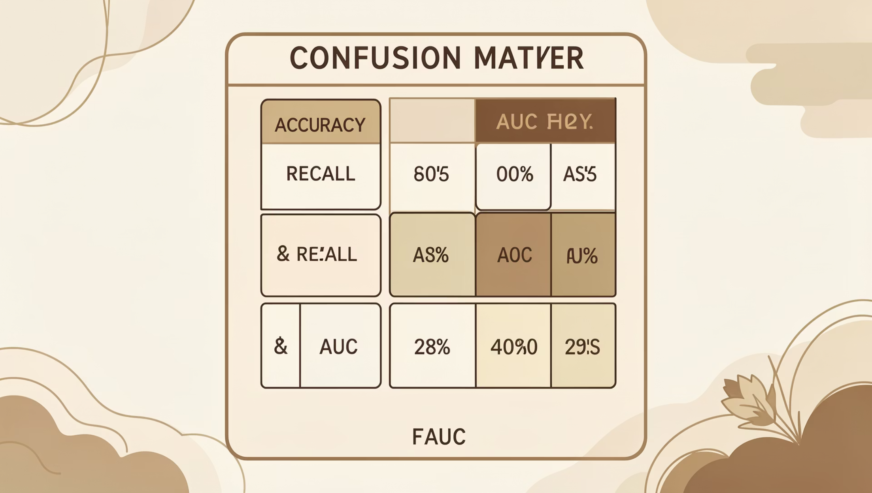
MODEL PERFORMANCE
Predictive Model Results: Logistic Regression
Our model accurately identifies at-risk customers, empowering proactive retention.
Accuracy: ~78%
Recall: ~75%
AUC: ~0.82 (strong discriminative power)
Risk Tier Distribution
High Risk (70–100%): ≈ 1,400 customers
Medium Risk (40–70%): ≈ 2,100 customers
Low Risk (0–40%): ≈ 3,500 customers

Slide 8
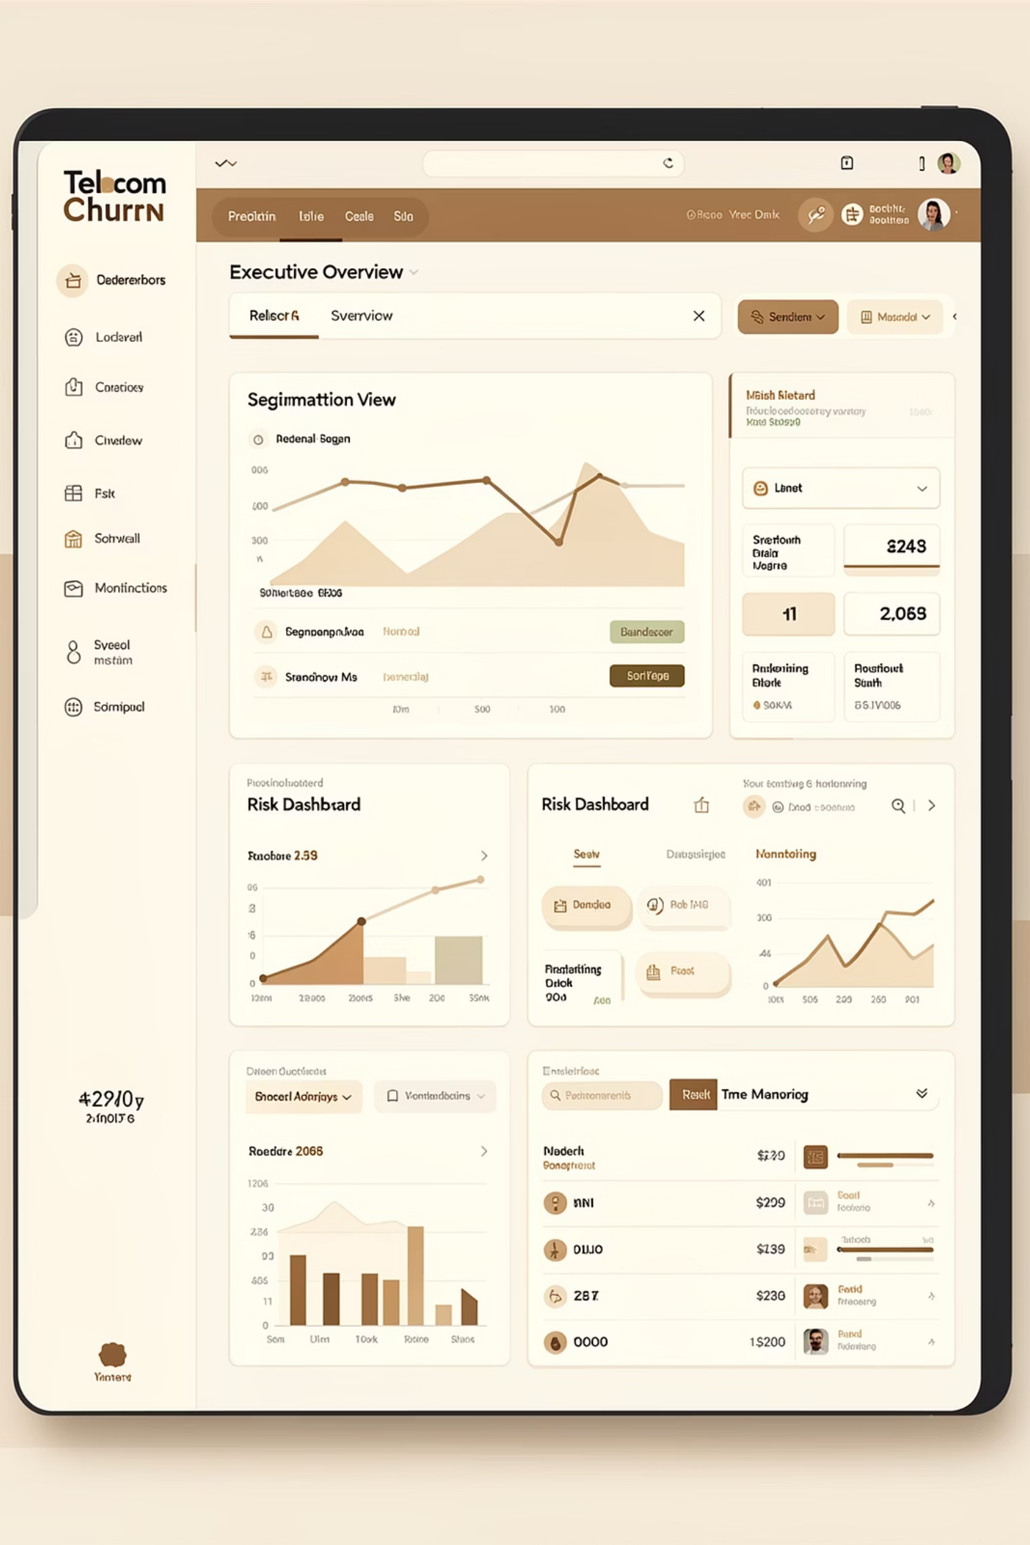
TOOLS
Product Analytics & Churn Monitoring Dashboard
Real-time insights for executive oversight and targeted interventions.
This dashboard provides an integrated view of churn metrics, allowing for dynamic tracking and strategic decision-making.

Slide 9



STRATEGY
Targeted Retention Strategy
A three-tiered approach to maximize retention effectiveness based on risk profiles.
High Risk
Medium Risk
Low Risk
Immediate, personalized interventions (e.g., dedicated support, special offers).
Proactive engagement (e.g., value communication, service enhancements).
Focus on loyalty programs, upsell opportunities, and positive reinforcement.

Slide 10
IMPACT
Projected Business Impact & ROI
Implementing this strategy will yield significant financial and operational benefits.
18.5%
₹4.13 Cr
₹4.63 Cr
1,262%
Reduced Churn
Revenue Saved
Total Annual Impact
Projected ROI
From 26.5% to 18.5%, saving valuable customer relationships.
Annually, from reduced customer attrition.
A significant return on a ₹45 Lakhs investment.
Including revenue saved and upsell opportunities.
Beyond financial gains, we anticipate improved NPS, customer satisfaction, and increased referrals.

